Slide 1
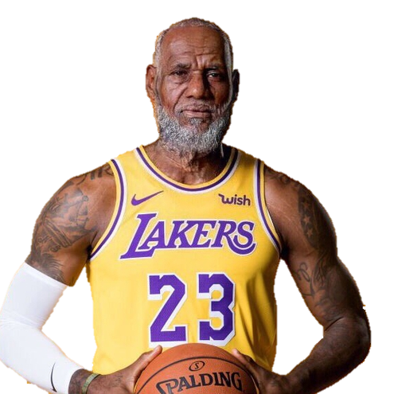
NBA CAREER predictor
Robert Johnson

Slide 2


Finding greatness
It Starts Early
Complicated
Many False Positives
Unknown Misses

Slide 3
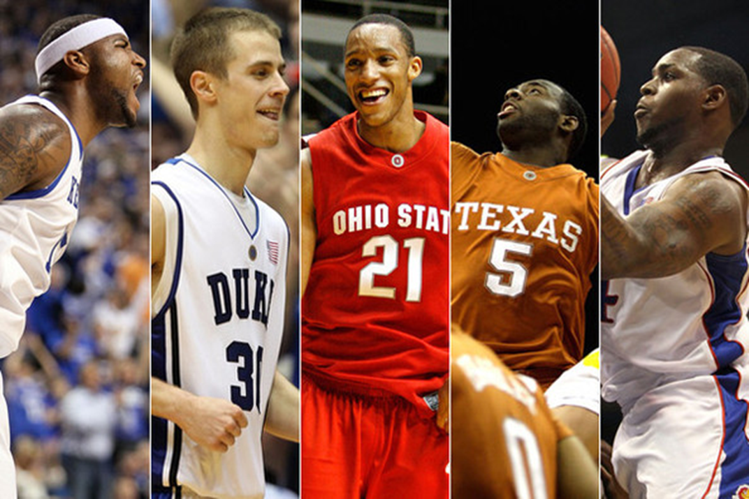
Deciding Greatness
Risky
Not A Science
Pays To Be Early

Slide 4

Problem Statement
Can we, by only looking at the tangible features of players who make it to the NBA, determine with reasonable certainty the length of the players NBA career.

Slide 5

Known knowns and known Unknowns
Knowns
Player Height
Weight
Position
Unknowns
Player motivation
Injury history
Skill level
Coachability

Slide 6
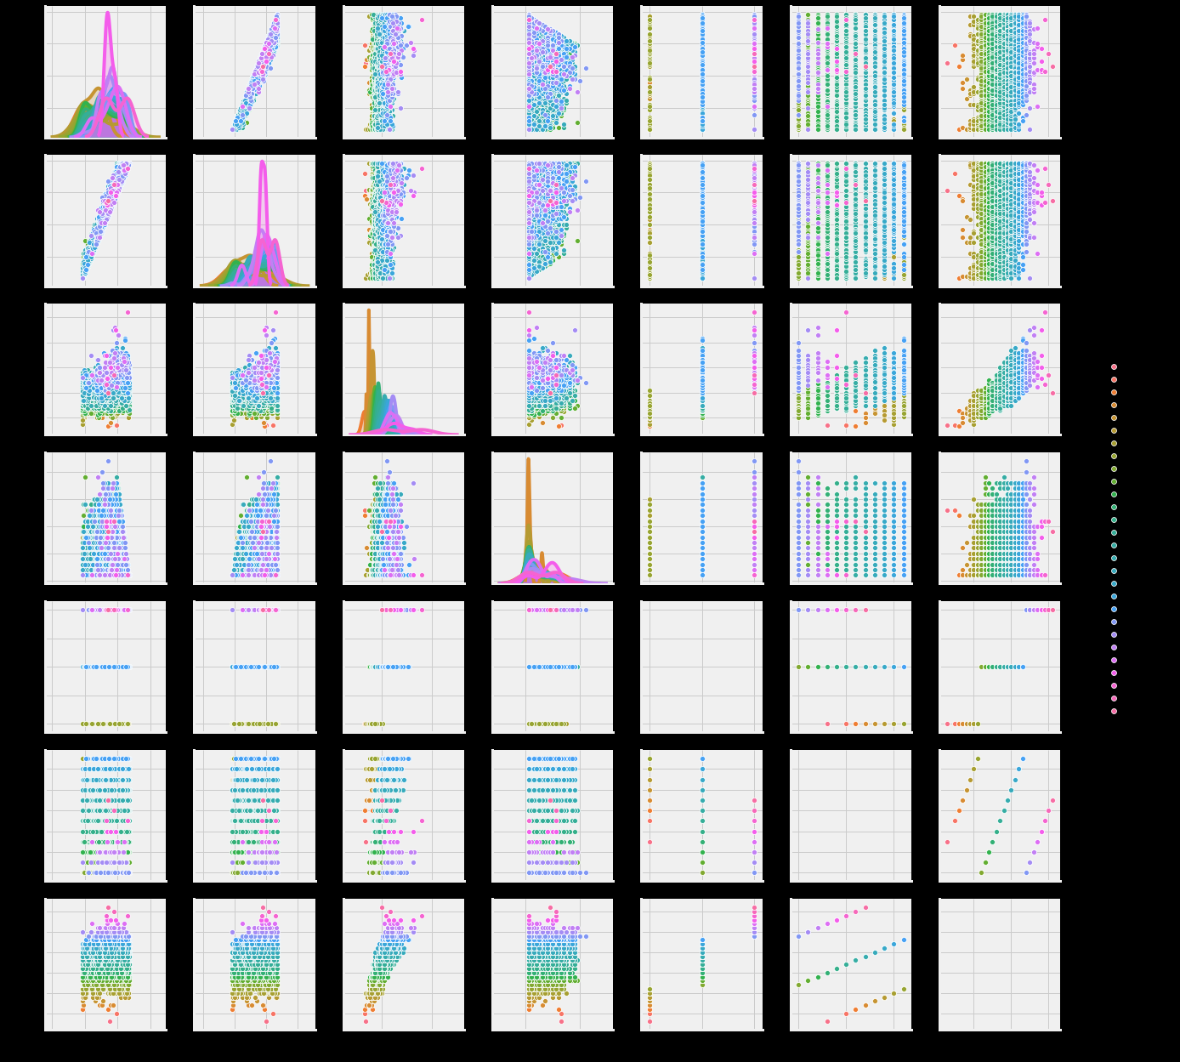
Project Approach
The problem described above is a prediction problem - I am attempting to predict the number of seasons played. I tested two different regression models for this problem. The first was a Linear regression model then a random forest model. I will use accuracy compared to null model as the primary metric to evaluate each model.

Slide 7

Model solution
Linear Regression
Compared to the null model this model delivered superior outperformance 7% of the time.
Random Forest Regressor
Compared to the null model this model delivered superior outperformance 14% of the time.

Slide 8
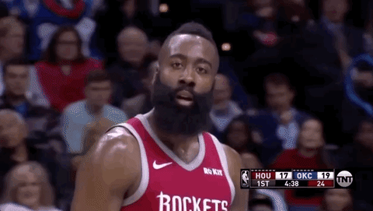
evaluation
BLUF: The models were unable to reliably predict player career length.
Actions taken:
Feature engineering
Combining data frames
Various other models

Slide 9
What does it mean
BLUF: You need more that the tangibles.
Height and Weight are very important indicators for athletes when they are young.
Height, Weight, and Position are less important among NBA players.
75% of player are within 5 inches and 20 pounds of each other this low variation is a limiting factor.

Slide 10

What is next
Adding more performance data to the model could improve the reliably of predicting career length.
Adding the injury and recovery history would also set the stage for a better model.

